Slide 1
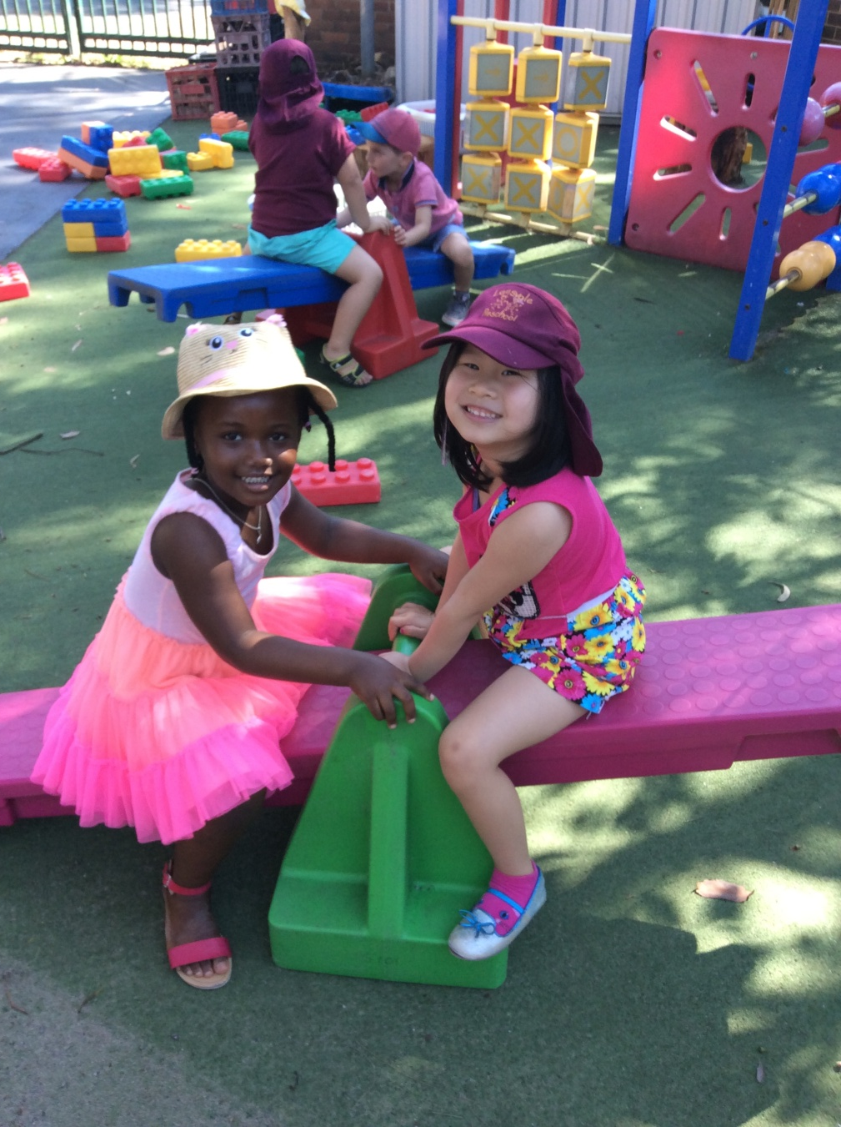
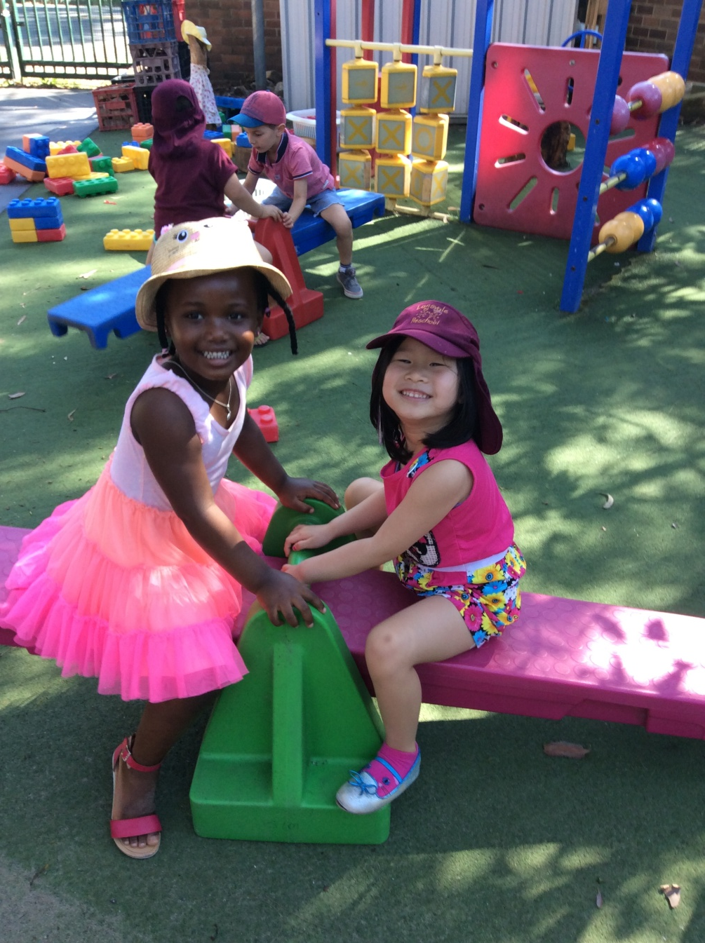
Beautiful Friends!

Slide 2
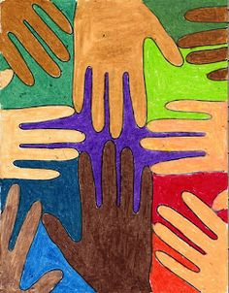
Written by Ms Lien Chai
The Story: “I don’t like Samantha, she is black” said Chanel. Some of the other children in class have also been making negative comments about the colour of Samantha’s skin. Ms Lien and Ms Anna decided that it was important to challenge Chanel and the children’s thinking and began planning experiences where the children got to learn about people from different cultures. Ms Tank, our school librarian found us some rich multicultural books, Ms Anna painted our handprints in various skin tones, Ms Yenny found puppets and dolls from various cultures and backgrounds and Ms Theresa made play dough in various shades of skin tone. Through books and multimedia Ms Lien exposed the children to the different lifestyles and traditions of people from all around the world. We celebrated the different skin tones of all the children in our class, emphasising that the different colours of our skin is what makes us unique and beautiful. These activities provided rich opportunities for us to have conversations with Chanel and the children about how we are all different and to accept, respect, and include people whom they may perceive as "different".
Today, Chanel sat with Samantha and said to Ms Anna. “Ms Anna, I wish I had skin like Samantha, its beautiful”. Ms Anna said you cant really have Samantha’s beautiful skin, its a different colour. Our quick thinking Chanel said “Well maybe I can paint my skin”. Ms Anna smiled with so much pride because she realised Chanel has learnt a very important life lesson in believing that beauty comes in all different shades and colours!
Analysis of Learning
Chanel is beginning to understand that although we may be of different nationalities, races, ethnicities, languages or faiths, and may live our lives very differently, but we all still have the same daily needs, hopes, and dreams.
We are very proud that we are able to change Chanel’s perception and acceptance of Samantha’s uniqueness.
Links to EYLF- Principle –Cultural Competence. Chanel is developing positive attitudes towards cultural differences.
Learning Outcome 2 – Chanel is noticing and reacting in positive ways to similarities and differences among people
Future directions
Continue to develop Chanel’s friendship with Samantha. Continue to explore the different culture, heritage and different backgrounds of our children and families so we can broaden Chanel’s perspective and further encourage appreciation of diversity.

